Slide 1

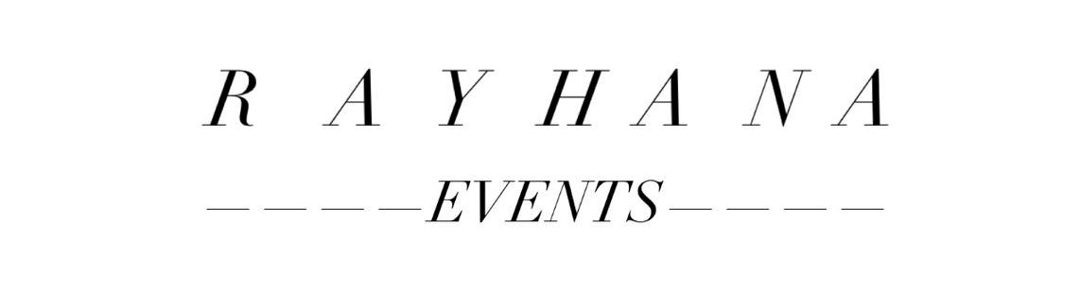
Setting a MERN app with this topic:
Wedding Planner Website
Presented by :
Rayhana Saula
Supervised by :
Khalil Salhi

Slide 2
Plan
Introduction
The use case Diagram Study
The Class Diagram Study
Features / optimisation
Conclusion

Slide 3
Introduction
For the design of our app we will adopt an object oriented method.
To better present the architecture of our system, we will choose the most widely adopted UML modeling language:
Let’s first discuss the topic of this project
Problems :

Slide 4
The proposed Wedding Event Planner system provides a smart way for users to book the venue for an event. The user can book the venue from anywhere and at any time which saves a lot of time and requires little physical effort. All the details given to users are stored in the database with high-level security which can be checked frequently and can be modified at any time by authorized members of the website .
Goals :

Slide 5
The use case Diagram Study
Use case | Actors
Login | Admin / User
User details | Admin
User request | Admin
Register | User
Reservations | User
Logout | Admin / user
Website’s overview | Visitor

Slide 6
Admin needs to get logged in by entering valid credentials.
Admin has visibility on all users registered details and can authorize them.
Admin can view users requests.
Admin :

Slide 7
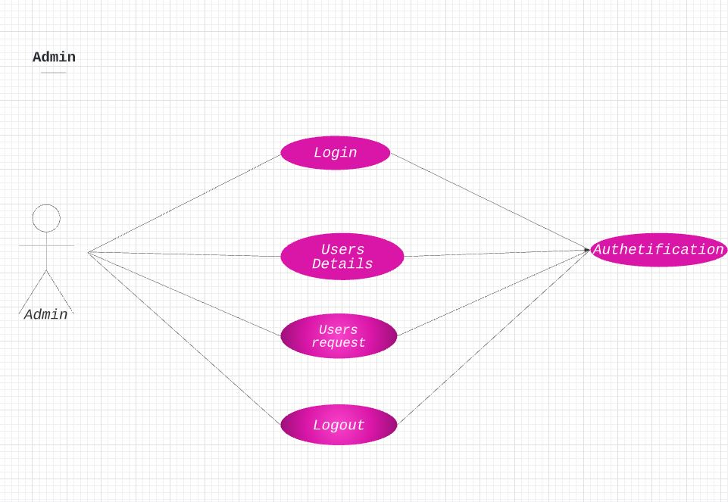

Slide 8
Registrating on the website is required by the user by entering all the details in the registration form. Every registered user should be validated by the admin.
The user can login by entering email and password.
User :

Slide 9
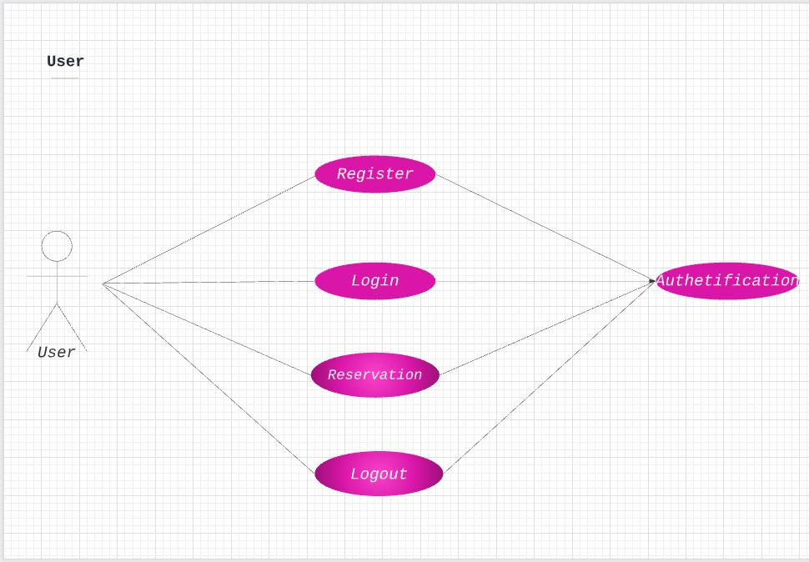

Slide 10
The visitor can only consult the website’s overview .
He can also register on the website by entering all the details in the registration form .
Visitor :

Slide 11
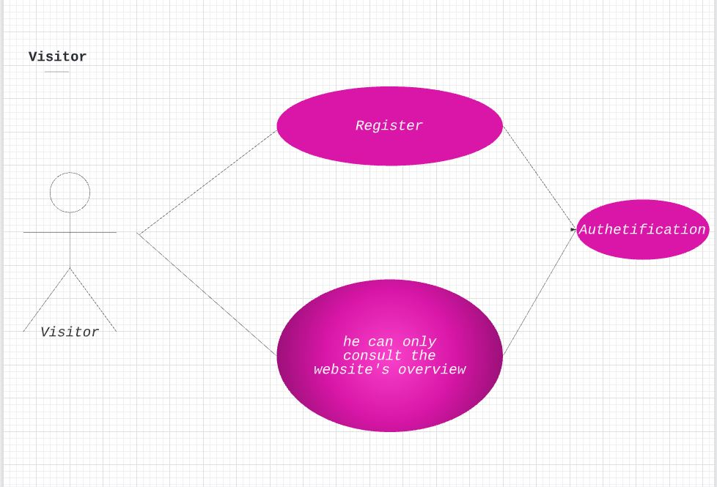

Slide 12
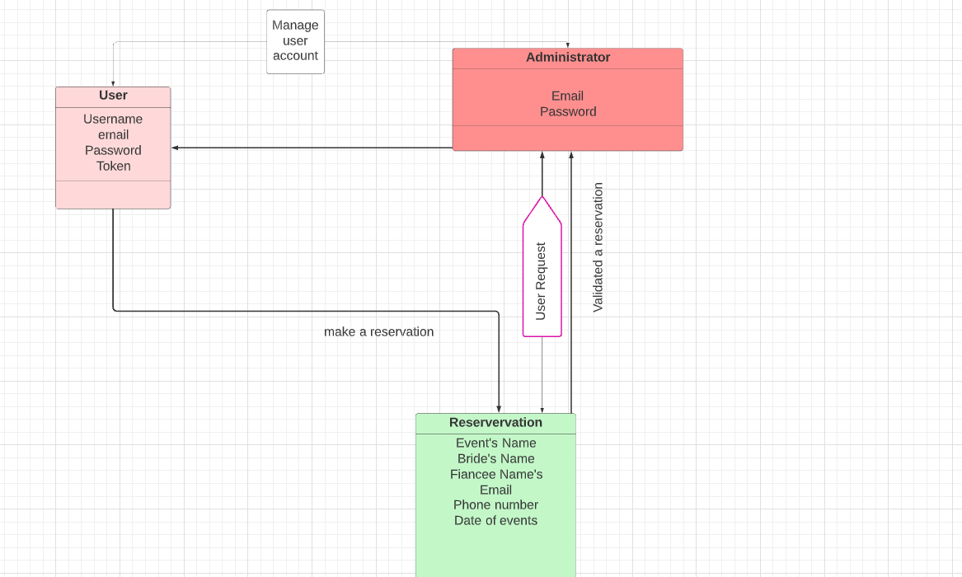

Slide 13
The use case Diagram Study
On our site, the user can book the venue from anywhere and at any time, saving a lot of time and effort.
He can also make a reservation date on the site.

Slide 14
Features / optimisation
To make an appointment, users must create an account and complete the reservation form .
The administrator can manage reservations, he can add, delete or modify appointments . He can also manage user’s account .

Slide 15
Thank You

